Slide 1
nkckps tkxrhd forj.k
nkc iVVs
Equatorial Low Pressure Belt or ‘Doldrums’-
fo’kqoo`fRr; deh nkc iVVk ¼ITCZ½%& fo’kqoo`Rriklqu dkgh va”khnqj gk deh nkc iVVk vk<Grks- ;k iVV;kr 1013 feyhckjis{kk deh nkc vk<Grks- gk fo’kqoo`Rrh; deh nkc iVVk gks;- gk vf/kd m’.krk o vf/kd vknzZrk vlysyk izns”k vlwu ;kyk “kkariM vls Eg.krkr- dkj.k ;sFks gok fLFkj vFkok laFk vlrs- deh nkc gk ckjkgh efgus lrr feG.kk&;k m’.krseqGs fuekZ.k gksrks-

Slide 2
fufeZrh
fo’kqoo`Rrkoj o’kZHkj lq;kZph fdj.ks yacor iMr vlY;keqGs ;k Hkkxkr lkSj”kDrhps izek.k tkLr vkgs-
lkSj”kDrhps izek.k tkLr vlY;keqGs ;sFkhy gok xje gksrs o ojP;k cktqyk foLrkfjr gksrs-
Xkje gok oj p<Y;keqGs fo’kqoo`Rrh; iVV;kr gospk Hkkj deh gksrks- R;keqGs ;k iVV;kyk fo’kqoo`Rrh; deh Hkkjkpk iVVk vls Eg.krkr-

Slide 4
gokeku
;k iVV;kr vfr”k; “kkar gok vk<Grs dkj.k ;sFks vfr”k; deh nkc vlrks-
;k iVV;kr tehuhojhy gok ulrs QDr laoguh; izdkjps izokg lq: vlrkr-
deh nkckP;k iVV;kr leqnzkps izek.k tkLr vkY;keqGs ;sFkhy gosr vknzZrsps izek.k Hkjiqj vlrs-
laoguh; okjs vknzZrk oj ?ksmu tkrkr- R;keqGs fo’kqoo`Rrh; izns”kkr es?kkaps izek.k tkLr vlrs-;k izns”kkr vojksgh itZU; iMrks-
;k iVV;kr vfr”k; rkieku vlqugh ;sFks pdzokr vk<Gr ukghr dkj.k fo’kqoo`Rrkoj dksjhvksyhl “kDrhpk vHkko vkgs-

Slide 5
fo’kqoo`Rrh; deh nkc iVVk 5 va”k mRrj rs 5 va”k nf{k.k v{ko`RrkaP;k njE;ku vk<Grks-
gk iVVk 20 va”k mRrj rs 20 va”k nf{k.k v{ko`RrkaP;k njE;ku lq;kZP;k fLFkrhuqlkj foLrkjhr gksrks-
fo’kqoo`Rrh; deh nkckpk iVV;kpk Hkkx gk nksUgh xksyk/kkZr vlysY;k miks’.k tkLr nkc iVV;krqu ;s.kkÚ;k okÚ;kaps laehyu {ks= vkgs-
;k iVV;kr gok vfr”k; “kkar vlY;keqGs ;k iVV;kyk “kkariM ¼MksyMªe½ vls Eg.krkr-
“kkariÍ;kP;k e;kZnk LFkyijRos o dkyijRos cnyr vlrkr-

Slide 6
Sub-Tropical High Pressure Belt or Horse Latitudes
miks’.kdfVca/kh; tkLr nkc iVVk%&lk/kkj.ki.ks 30 va”k mRrj o nf{k.k v{ko`RrktoG tkLr nkc iVVk vk<Grks- ;kauk v”ov{ko`Rrs vls Eg.krkr-;k iVV;kapk mxe nksu izdkjs vlq “kdrks-
i`FohP;k ifjHkze.kkeqGs fo’kqoo`Rrh; izns”kkr dsnzksilkjh “kDrheqGs map okrkoj.kkrhy gok mRrjsdMs o nf{k.ksdMs <dyyh tkrs- gh gok 30 va”k v{ko`RrakP;k njE;ku [kkyh mrjrs- o R;keqGs rsFks tkLr nkc izns”k fuekZ.k gksr vlkok-
R;kpizek.ks /zkqokdMwu fo’kqoo`RrkdMs ns[khy ojP;k okrkoj.kkr gosph gkypky gksrs- gh gok ns[khy v”o v{ko`Rrkr [kkyh mrjrs o nksUgh L=ksrkdMwu feGkysY;k goseqGs ;sFks tkLr nkckps iVVs r;kj gksrkr-

Slide 7
fuehZrh
fo’kqoo`fRr; iVV;krhy ojP;k cktqyk mpyyh xsysyh gok ;k iÍ;kr mrjrs- gh mrj.kkjh gok FkaM o tM vlrs R;keqGs rh dksjMh vlrs-
gh dksjMh o FkaM gok 30 va”k mRrj o 30 va”k nf{k.k v{kaak”kkP;k njE;ku mrjrs-
;k goseqGs ;sFks tkLr Hkjkpk iÍk r;kj gksrks-
dksjhvksyhl “kDrheqGs ojhy gopk ifj.kke gksÅu gospk nkc tkLr vlrks-

Slide 8
gokeku
miks’.k dfVca/kh; tkLr nkc iÍ;kr gok xje o dksjMh vlY;keqGs ;k iÍ;kr nksUgh xksyk/kkZr okGoaVh izns”k vk<Grkr-
;k iÍ;kr gosps lapyu izfrpdzokrh; Lo:ikps vk<Grs-
;k iÍ;kdMwu fo’kqoo`fRr; deh nkc iÍ;kdMs O;kikjh okjs okgrkr-
;k iÍ;kr vkorZ ;srkr-

Slide 9
v”o v{ko`Rrs
ddZ vkf.k edj o`RrktoGP;k tkLr nkckP;k iÍ;kyk v”o v{kka”k Eg.krkr-
;k Hkkxkr gok ,dlkj[kh [kkyh mrjr vlrs-v{ko`Rrkauk iqohZP;k dkGh f”kMkP;k tgktkus tyi;Zvu dj.kkÚ;k [kyk”kkauk ;k Hkkxkrqu izokl dj.ks Qkj thdjhps vls-;k iÍ;kr okÚ;kP;k vHkkoh tgkts [kksGacwu jkgkr vkr o v”kk osGh tgktkaoj vUuik.;kpk lkBk lqiwu tkÅ u;s Eg.kwu O;kikjklkBh >ksrysY;k >kksM;kauk ukbZyktkus leqnzkr yksVqu +|kos ykxs- Eg.kwu ;k Hkkxkrhy “kkar iÍ;kauk v”o v{kka”k vls uko iMys vkgs-

Slide 10
m’.kdfVca/kh; okGoaVs mRrj xksyk/kkZr [kaMkP;k if”pe Hkkxkr 20 va”k rs 30 va”k v{kka”kkaP;k njE;kup dk vk<Grkr-\
dkj.k mRrj xksyk/kkZr FkaM izns”kkMwum’.k izns”kkdMs okgr vlY;keqGs lkekU;r% R;kaps rkieku vf/kd ok<wu ck’ixzg.k {kerk ok<rs- Eg.kts lkis{kr;k rs dksjMs vlrkr- mcnkj lkxjh Hkkxko:u lkis{kr;k FkaM [kaMHkkxkoj vkY;kl ;k okÚ;kaiklwu ikÅl feGrks- R;krgh R;kaP;k fn”kseqGs [kaMkP;k iwoZHkkxkr gs FkksMk ikÅl nsrkr o if”pe Hkkx ek= iw.kZ dksjMs jkgrkr- Eg.kwup O;kikjh okÚ;kaP;k iÍ;kr m’.kdfVca/kh; okGoaVs [kaMkP;k if”pe Hkkxkr vk<Grkr-

Slide 13
Sub-Polar Low Pressure Belt
mi/kzqfo; deh nkc iVVs %& /kzqoktoGhy izns”kkr mi/kzqoh; deh nkc iVVs vk<Grkr- ;k deh nkc iVV;kaps ,d dkj.k i`Fohps ifjHkze.k vlwu /kzqoktoGhy izns”kkrhy gose/;s pdzkdkj xrh fuekZ.k gksmu rsFks deh nkckph izo`Rrh fuekZ.k gksrs- izR;{k /kzqokoj ek= xrhf”ky ifj.kkekis{kk rki ifj.kke egRokpk Bjrks- R;keqGs mi/kzqoh; deh nkc iVVs fo’kqoo`RrkdMhy cktqoj fuekZ.k gksrkr-

Slide 14
/kzqokoj xfrf”ky ifj.kkekis{kk rki ifj.kke vf/kd egRokpk B:u deh nkckps iÍs vkfdZDV o vaVkfDVd o`RrkP;k oj 65 va”k mRrj nf{k.k va{kk”kktoG vk<Grkr-
mRrj xksyk/kkZr /kzqoh; deh nkckps dsanz nksu Hkkxkr foHkkxysys vk<Grkr-R;kauk vkblyM deh nkc o vWY;qf”k;u fMizs”ku ¼vWY;qf”k;u yks½ ;k ukokus vksG[kys tkrs-
nf{k.k xksyk/kkZr v”kk izdkjps foHkkx vk<Gr ukghr-

Slide 15
fufeZrh
/kzqfo; izns”kkr deh nkckps dkj.k i`fFops ifjHkze.k vlwu /kqzoktoGhy izns”kkr gose/;s pdzkdkj xrh fuekZ.k gksrs-
iqfFoP;k ifjHkze.kkeqGs dksfjvksyhl “kDrhph fuehZrh gksrs-
Dksjhvksyhl “kDrheqGs okjs /kqzaoh; Hkkxkr iqosZdMqu okgrkr-
Fo’kqoo`Rrh; HkkxkP;k cktqyk ;k iÍ;kph fuehZrh gksrs-

Slide 16
=qrquqlkj cny
Tkehu o ik.;kP;k fo’ke forj.kkeqGs fgokG;kr gk iÍk [kafMr gksrks- o nksu dsanzs fuekZ.k gksrkr-
mUgkG;kr gk iÍk vkiY;k eqG fLFkrhr ;srks-

Slide 17
;k izns”kkrhy FkaM o xje ok;qjk”kkhaeqGs /kzqof; tsV izokgkaph fufeZrh 60 va”k va{k”kknjE;ku gksrs-o R;kpk izHkko deh nkckoj gksrks-
mi /kzaoh; deh nkckP;k izns”kkr miks’.k tkLr nkckdMqu ;s.kkjh gok o /kzqoh; izns”kkdMwu ;s.kkjh gok feGrkr R;keqGs /kzqoh; vk?kkmhph fuehZrh gksrs-

Slide 18
Polar High Pressure Belt
/kzqoh; tkLr nkc iVVs %&vaVkfVZd fge[kaMkP;k ojhy okrkoj.kkr vfr”k; FkaM o ?ku gok vlrs- rsFks /kzqoh; tkLr nkc izns”k fuekZ.k gksrks- vkfDVd izns”k nkc forj.kkP;k n`’V;k vfr”k; xaqrkxaqrhpk vkgs- dkj.k egklkxjh; HkxkHksorh [kaMizns”k iljys vkgsr-/kzqoh; tkLr nkc deh izns”kkr vk<Grks-gk iÍk nksUgh xksyk/kkZr 80 va”k rs 90 va”k v{kka”kknjE;ku vk<Grks-

Slide 19
fuehZrh
/kzaoh; izns”kkrhy gok vfr”k; FkaM o ?ku vlrs-
FkaM goseqGs ;sFks tkLr nkckpk izns”k fuekZ.k gksrks-
vaVkfDVZd fge[kaMkP;k ojhy okrkoj.kkr vfr”k; FkaM o ?ku gok vlrs- vkfDVZd izns”k nkc forj.kkP;k ckcrhr vfr”k; xaqrkxqarhpk vkgs- dkj.k egklkxjkHkksorh [kaMizns”k iljysys vkgsr-

Slide 20
gokeku
/kzqoh; izns”kkr loZ= vfr”k; FkaM gok vlrs-

Slide 21
nkc izns”k o O;kikjh okjs

Slide 22
ojhy lk/;k vkn”kZ nkc forj.kkr egRokpk lq/kkj ?kMqu ;srks rks tehu vkf.k ik.kh ;kP;k Hkqi`’Bkojhy forj.kkeqGs- vls fo”ks’kRokus mRrj xksyk/kkZr ?kMwu ;srs- R;keqGs +_rqijRos rkiekukr mYys[kuh; cny ?kMwu ;srkr- v{ko`Rrizek.ks dsysys vkn”kZ fLFkrhrhy nkc iÍs [afMr gksrkr-
fgokG;kr [kaMkP;k FkaM varxZr Hkkxkr tkLr nkckps fo”kky iÍs foLrkfjr gksrkr-
mUgkG;kr ;k rkiysY;k [kaMHkkxkoj deh nkckps rhoz Lo:ikps iÍs fuekZ.k gksrkr-
gk ifj.kke nf{k.k xksyk/kkZr tehuhps Hkkx Qkj FksMs vlY;keqGs brdk lqLi’V fnlr ukgh- nf{k.k xksyk/kkZrhy mUgkG;kr fo’kqoo`Rrh; deh nkc iÍk nf{k.ksdMs [akMHkkxkoj FkksMk vf/kd foLrkjrks gk viokn oxGrk] miks’.k dfVca/kh; tkLr nkc iÍ;kr fo’ks”k [kaM iMr ukgh- nf{k.k leqnzkrhy dehnkc iÍk ek= o’kZHkj lyx vlk dk;e jkgkrks-

Slide 23
mRrj xksyk/kkZr ek= vkn”kZ fLFkrhrhy nkc iÍs [kqip [afMr gksrkr- v”kk lyx iÍ;ka,oth dII;kdII;kr fuekZ.k >kysyh =qrquqlkj deh o tkLr nkckP;k dsanzkaph ekfydkp r;kj gksrs-
tqySe/khy nkc fLFkrh ¼mUgkGk½
mUgkG;kr ;sFkhy tkLr rkiekukeqGs vkf”k;kP;k o mRrj vesjhdsP;k Hkkxkoj deh nkc izns”k fuekZ.k gksrkr-
vkf”k;kP;k deh nkc izns”kkps dsanz ok;O; Hkkjrkr rj mRrj vesjhdsP;k deh nkckps dsanz mRrj esfDldksr r;kj gksrs-
gs deh nkc izns”k fo’kqoo`Rrh; deh nkc izns”kkpsp mRrjsdMhy foLrkj gksr- ;k deh nkc izns”kkeqGs miks’.k dfVca/kh; tkLr nkc iÍk [kafMr gksrks- R;kr mRrj vVykafVd o mRrj iWflQhd egklkxjkps Hkkx ek= iq.kZi.ks tkLr nkckps izns”k Eg.kwu lyx dk;e jkgkrkr- R;kauk d/kh d/kh vuqdzes v>ksfj;u o gokbZ;u deh nkckps izns”k Eg.krkr-

Slide 24
tqySe/khy nkc forj.k

Slide 25
Tkkusokjhrhy nkc fLFkrh ¼fgokGk½
fgokG;kr ;qjsf”k;kP;k o mRrj vesfjdsP;k fo”kky [kaMHkkxkoj mPp nkc izns”k fuekZ.k gksrkr- R;kposGh mRrj vVykafVd o o mRrj iWflfQd egklkxjkoj deh nkckph dsanzs vlrkr-

Slide 26
Tkkusokjhrhy nkc forj.k

Slide 27
nkc iÍ;kaps vkanksyu
Lqk;kZP;k mRrj o nf{k.k xksyk/kkZr tk.;keqGs rkiekukr iM.kkÚ;kk Qjdkrwu nkciÍs ns[khy fdaphr mRrjsdMs vFkok nf{k.ksdMs ljdrkr- ;kyk nkciÍ;kaps vknksyu vls Eg.krkr-
lq;Z ddZo`Rrkoj vlrkauk nkckps iÍs 5 va”k mRrjsdMs ljdrkr-
0 rs 5 va”k vlysyh fo’kqoo`Rrh; deh nkc iÍ;kph lhek 0 va”k rs 10 va”k mRrj gksrs-
25 va”k rs 35 va”k njE;ku vlysY;k tkLr nkc iÍ;kps LFkykarj 35 va”k rs 40 va”k mRrj v{ko`Rrk njE;ku gksrs-
60 va”k rs 70 va”kk njE;ku vlysY;k deh nkc dsanzkps LFkykarj 65 va”k rs 75 va”k mRrj v[ko`RrjnjE;ku gksrs-
lq;Z edjo`Rrkoj vkY;koj ;k loZp iÍ;kaP;k lhek iqUgk 5 va”kkus nf{k.ksdMs ljdrkr-
nkc iÍ;kaP;k vkanksyukps fuf”pr ifj.kkegh vk<Gwu ;srkr-

Slide 28
nkciÍ;kaps vkanksyu

Slide 29
xzgh; okjs ¼planetary winds½
i`Fohoj gosP;k deh tkLr nkckps iÍs fuekZ.k >kY;keqGs tkLr nkckP;k iÍ;kdMwu deh nkckP;k iÍ;kdMs okjs okgrkr- ;k okÚ;kauk xzgh; okjs Eg.krkr- gs fu;her Lo:ikps okjs vlrkr o R;kaps ,d fuf”pr {ks= o i/nrh Hkw&xksykoj vk<Grs- ;k okÚ;kaps ,dw.k rhu xV iMrkr-
1½O;kikjh okjs
2½ izfrO;kikjh okjs
3½/k`oh; okjs

Slide 30
xzgh; okjs (Planetary winds)

Slide 31
O;kikjh okjs ¼Trade winds or Esterlies½
nksUgh xksyk/kkZrhy 25 va”k rs 35 va”k v{ko`RrknjE;ku iljysY;k tkLr nkckP;k iÍ;kdMqu fo’kqoo`RrkdMhy deh nkc iÍ;kdMs okg.kkÚ;k okÚ;kauk O;kikjh okjs vls Eg.krkr- okLrfod gs okjs iqosZdMwu if”pesdMs okg.kkjs vlrkr- Eg.kwu R;kauk iwohZ; okjs ¼easterlies½ vls Eg.krkr- i`FohP;k ifjHkze.kkeqGs R;kaP;k fn”ksr fo{ksi fuekZ.k gksrks- o rs QsjsyP;k fu;ekuqlkj mRrj xksyk/kkZr R;kaP;k mtohdMs o nf{k.k xksyk/kkZr R;kaP;k MkohdMs oGrkr- mRrj xksyk/kkZr gs okjs bZ”kkU;sdMwu uS_R;sdMs okgr vlY;kus R;kauk bZ”kkU; O;kikjh okjs vls Eg.krkr- nf{k.k xksyk/kkZr rs vkXus;dMwu ok;O;sdMs okgrkr Eg.kwu R;kauk vkXus; O;kikjh okjs vls Eg.krkr-
FkaM izns”kkdMwu m’.k izns”kkdMs okgr ;sr vlY;keqGs lkeku;r;k R;kaps rkieku vf/kd ok<wu ck’ixzg.k {kerk ok<rs- Eg.kts lkis{kr;k rs dksjMs vlrkr-mcnkj lkxjh Hkkxko:u lkis{kr;k FkaM [kaMHkkxkoj vkY;kl ;k okÚ;kaiklwu ikÅl feGrks- R;krgh rs R;kaP;k fn”kkaeqGs [akMkP;k iwoZHkkxkr FkksMk rjh ikÅl nsrkr o if”pke Hkkx ek= iw.kZ dksjMs vlrkr- Eg.kwup O;kikjh okÚ;kaP;k iÍ;kr [kaMkP;k if”pe Hkkxkr m’.kdfVca/kh; okGoaVs vk<Grkr-

Slide 32
izfrO;kikjh okjs ¼Anti-trade winds or Westerlies½
nksUgh xksyk/kkZr 25 va”k rs 35 va”k v{kka”kkP;k njE;ku iljysY;k tkLr nkc iÍ;kdMqu 60 va”k v{ko`RrkP;k njE;ku vlysY;k deh nkc izns”kkdMs ts okjs okgrkr R;kauk izfrO;kikjh okjs vls Eg.krkr- ;k okÚ;kauk if”peh okjs vls Eg.krkr- ;k okÚ;kaph loZlkekU; fn”kk if”pesdMwu iwosZdMs vlyh rjh i`FohP;k ijhHkze.kkeqGs fo{ksfir gksrks- mRrj xksyk/kkZr R;kaph fn”kk uS_R;sdMwu bZ”kkU;sdMs vlrs Eg.kqu ;kauk uS_R; izfrO;kikjh okjs vls Eg.krkr-rj nf{k.k xksyk/kkZr ;kaph fn”kk ok;O;sdMwu vkXus;dMs vlrs- Eg.kwu ;kauk ok;O; if”peh okjs vls Eg.krkr-
If”peh okjs m’.k izns”kkdMwu FkaM izns”kkdMs okgrkr- R;keqGs rs [kaMkP;k if”pe Hkkxkr o’kZHkj ikÅl nsrkr- ifj.kker% e/;dfVca/kkrhy ;k okÚ;kaP;k {ks=krhy [kaMkps iwoZ Hkkx dksjMs jkfgY;keqGs okGoaVh cuys vkgsr- mRrj xksyk/kkZr vkorZ o izR;korkZaph ;k Hkkxkr tkLr fuehZrh gksr vlY;keqGs R;kaP;k ekxkZoj if”peh okÚ;kapk ifj.kke gksrks- nf{k.k xksyk/kkZr 40 va”k v{ko`RrkifydMs tehuhpk Hkkx toGtoG ulY;keqGs ;k Hkkxkr gs okjs vfr”k; osxkus okgrkr- R;keqGs rsFks R;kauk xtZ.kkjs pkGhl ¼roaring forties½vls Eg.krkr- 50 va”k nf{k.k v{ko`RrkifydMs rj ;k okÚ;kauk Qkjp osx ;srks R;keqGs uarj R;kauk [koGysys iUukl ¼furious fifties ½vls lacks/kys tkrs-

Slide 33
/k`oh; okjs ¼polar easterilies½
/k`oktoGhy tkLr nkckP;k izns”kkdMwu 60 va”k v{kka”kktoGhy deh nkckP;k iÍ;kdMs mRrj o nf{k.k xksyk/kkZr ts okjs okgrkr R;kauk /k`oh; okjs Eg.krkr- gs okjs iwodMwu okgr ;sr vlY;keqGs ;kauk /k`oh; iwohZ okjs vls Eg.krkr- ;sFksgh okÚ;kps fo{ksi.k gksÅu rs MkohdMs oGrkr o i`FohP;k ifjHkze.kkeqGs fuehZr “kDrheqGs rsFks gospk Hkksojk fuekZ.k gksrks-

Slide 34
LFkkfud okjs ¼Local winds½
Hkwi`’Bkojhy fu;her okÚ;kaf”kok; ygku ygku {ks=kr Lfkkfud rkiekukph fLFkrh] vknzZrk] HkqHkkxkps vkdkj bR;knh dkj.kkaeqGs dkgh fu;fer okg.kkjs i.k vYi izek.kkojhy okjs fuekZ.k gksrkr- R;kaP;k ifj.kkekps Lo:I R;k R;k {ks=kiqjrsp e;kZfnr vlrs- izknsf”kd gokekukP;k ?kVukaP;k lanHkkZr R;kauk fuf”pr egRo vlrs-
[kkjs okjs o erybZ okjs ¼sea and land breezes½
tehu vkf.k ik.kh ;kaP;k deh tkLr m’.krk xzg.k dj.;kP;k o rh mRlftZr dj.;kP;k fHkUu lkeF;kZeqGs “kstkjP;k tehu o leqnzh Hkkxkoj nkckP;k ckcrhr fojks/kkh ifjfLFkrh fuekZ.k gksrs o R;krwu [kkjs o erybZ okjs fuekZ.k gksrkr-
[kkjs okjs%&fnolk lw;kZP;k m’.krsus tehu yodj rkirs o rsFks deh nkckpk izns”k fuekZ.k gksrks- R;kposGh “kstkjP;k leqnzkps ik.kh FkaMp vlrs o R;keqGs rsFks nkc tkLr vlrks- izFke rkiekukph o uarfj nkckph vleku fLFkrh fuekZ.k >kY;keqGs leqnzko:u vksylj vls okjs tehuhdMs okgw ykxrkr- R;kauk [kkjs okjs vls Eg.krkr-

Slide 35
[kkjs okjs fdukjiÍ;kaps gokeku lkSE; o vknzZ djrkr- [kkÚ;k okÚ;kaph fuehZrh nqikjh 12 uarj tsOgk Hkwi`’B iqjsls rkirs rsOgk leqnzkdMwu gs okjs okgw ykxrkr- la/;kdkGP;k lqekjkl gs okjs {kh.k gksrkr o lkekU;i.ks jk=h vkB oktsuarj ;kaps ogu iw.kZ can gksrs-
erybZ okjs %& fnolk xzg.k dsysY;k m’.krsps jk=h mRltZu gksrs- gs mRltZu dj.;kph tehuhph {kerk tkLr vlY;keqGs Hkwi`’B yodj FkaM gksrs- R;keqGs jk=h tehuhoj tkLr Hkkjkpk izns”k fuekZ.k gksrks- R;kekukus tyHkkx mcnkjp vkrks- ifj.kker% rsFks deh Hkkj vlrks- R;keqGs jk=h tehuhojhy tkLr HkkjkdMwu leqnzkojhy deh HkkjkdMs okjs okgw ykxrkr- R;kauk erybZ okjs vls Eg.krkr- erybZ okjs leqnzkdMs dksjMs okjs Eg.kwu okgrkr- [kkjs okjs okg.ks FkkacY;kuqrj erybZ okjs okgrkr o ldkG Ik;Zar rs okgrkr-

Slide 36
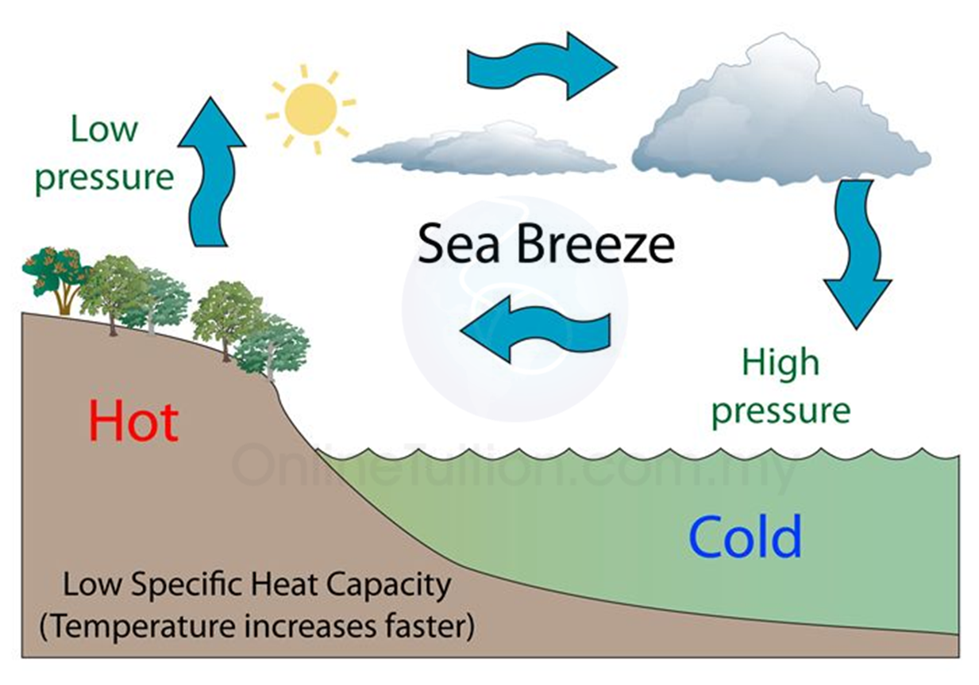
[kkjs okjs o erybZ okjs ¼sea and land breezes½

Slide 37
Mksaxj o njh okjs
Mksaxj okjs %&ioZrkaP;k ekF;kauk o mrkjkojhy Hkkxkauk fnolk feGkysY;k m’.krsps lw;kZLrkuarj mRltZu gksrs-rs Hkkx FkaM gksrkr o R;k Hkkxkr gospk tkLr Hkkj fuekZ.k gksrks-myV nÚ;kaps rGHkkx R;kekukus m’.k vlrkr o R;k Hkkxkoj gospk deh Hkkj vlrks- Eg.kwu jk=hP;k osGh ioZr HkkxkdMwu nÚ;kadMs FkaM vkf.k tM gok [kkyh <dyyh tkrs-ifj.kker% MksaxjkP;k ekF;ko:u njhdMs okjs okgw ykxrkr- ;k okÚ;kauk Mksaxj okjs vls Eg.krkr- ;k okÚ;kauk vWukcsVhd okjs vls Eg.krkr- njhdMs FkaM gok osxkus [kkyh ;sr vlY;keqGs njhrhy m’.k o gydg gok oj <dyyh tkrs-
njh okjs %& lw;kZsn;kuarj ioZrkP;k ekF;kojhy Hkkxkr lw;kZph fdj.ks loZizFke iMrkr- R;keqGs ioZrkrhy nÚ;kaP;k Hkkxkais{kk ioZrkP;k ekF;kojhy gok rkiwu izlj.k ikors o rsFks gosP;k deh Hkkjkpk izns”k fuekZ.k gksrks- i.k R;kp osGh ioZrkrhy nÚ;kaP;k Hkkxkoj gok FkaM vlY;keqGs gospk tkLr Hkkj fuekZ.k gksrks- ;kpk ifj.kke Eg.kts fnolk nÚ;kaP;k rGHkkxkdMwu ioZrkdMs okjs okgw ykxrkr- ;kauk njhrhy okjs vls Eg.krkr- ;kaukp dWVkcsfVd okjs vlsgh Eg.krkr-

Slide 38
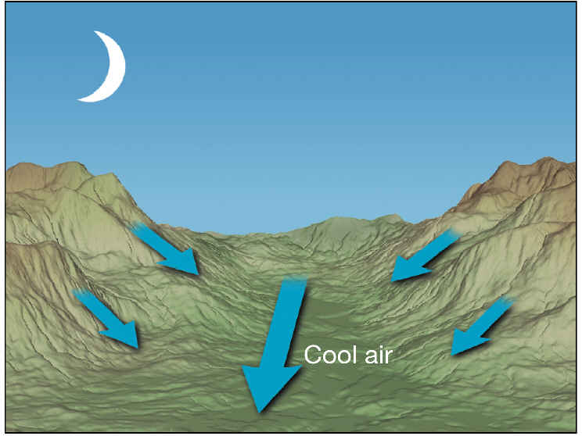
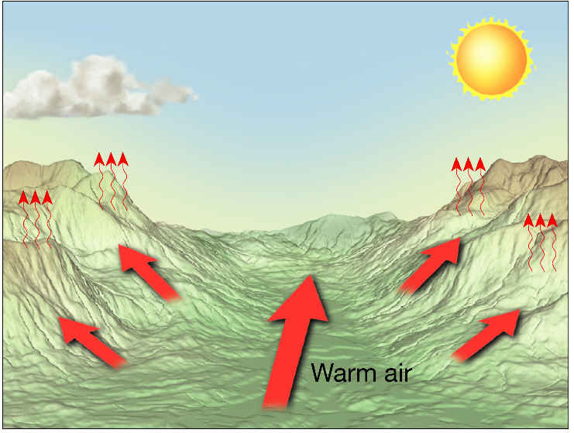
Mksaxjh okjs o njhrhy okjs ¼Mountain winds and valley winds½

Slide 39
ioZrjkaxko:u [kkyh mrj.kkjs okjs ¼Descending winds½
QkWu okjs %& ;qjksi [akMkrwu if”pesdMwu iwosZdMs izokl dj.kkÚ;k vkorkZa”kh ;k okÚ;kaP;k fuehZrh”kh lac/k vlrks-vkorZ fu?kwu xsY;koj gs okjs okgw ykxrkr- mUgkG;kr fdaok fgokG;kr vkorkZaP;k vkxeukeqGs bVyhP;k eSnkuh izns”kkojgosP;k tkLr Hkkjkps izns”k fuekZ.k gksrs-;k izns”kko:u vkYIk ioZrkdMs okjs okgw ykxrkr- gs okjs vkYIl ioZrkP;k nf{k.k cktwo:u p<rkr- ;k Hkkxkr ;k okÚ;kcjkscj okgwu vkysY;k ck’ikps lkafnzHkou gksÅu nf{k.k mrkjkoj FkksMklk ikÅl iMrks] ijarq vkYIl ioZr vksykaMwu gs okjs mRrj mrkjko:u [kkyh mrjrkr- okjs [kkyh mrjr vlY;keqGs rs m’.k o dksjMs gksrkr-gs okjs ÚgkbZu vkf.k Úgksu u|kaP;k [kksÚ;ko:u ftfuOgk ljksojki;Zar okgr tkrkr- ;k okÚ;kaeqGs mRrj mrkjkojhy cQZ forGrks] dkj.k ;k okÚ;kaeqGs rkieku dkgh rklkarp 20 va”k QW- us ¼lqekjs 6-7 va”k lsaz- xzs-½ ok<rs- gs okjs brds dksjMs vlrkr dh vkx ykx.;kpk usgeh laHko vlrks-

Slide 40
QkWu okjs ¼Foehn winds ½

Slide 41
fpuwd okjs %&
gs okjs QkWu okÚ;kalkj[ksp m’.k o dksjMs okjs vkgsr- mRrj vesfjdsP;k if”pe fdukÚ;kojhy O;ksfeax] vYcVkZ o dksyksjWMks ;k Hkkxko:u jkWdh ioZrkyk vksykaMwu gs okjs jkWdh ioZrkP;k iwoZ mrkjko:u [kkyh okgr vlrkr-iwoZ mrkjkoj gs okjs m’.k o dksjMs vlrkr- R;keqGs ;k izns”kkps rkieku FkksM;k”kk dkyko/khrp 30 va”k QW-¼lqekjs 1 va”k lsa- xzs-½ us ok<rs- ;k okÚ;kaeqGs ns[khy jkWdh ioZrkP;k iwoZ mrkjkojhy cQZ forGwu xorkph dqj.ks fgokG;kr xqjkalkBh eksdGh gksrkr-
ioZrkP;k mrkjko:u [kkyh mrj.kkjs ;k izdkjps okjs brj Hkkxkrgh vk<Grkr- bjk.ke/khy ioZrHkkxkrwu okg.kkÚ;k v”kk okÚ;kauk lsequ Eg.krkr- U;q>hyaMe/;s ukWjosLVlZ Eg.krkr- nf{k.k vkfQzdsP;k iBkjh Hkkxkrwu dsi fdukjÚ;kdMs okg.kkÚ;k okÚ;kauk cxZ o dWfyQksfuZ;kr ;k okÚ;kauk lWaVk&vWukl vls Eg.krkr-

Slide 42
fpuqd okjs ¼chinook winds½

Slide 43
okGoaVh okjs
mUgkG;kr nqikjh tehuhpk ,[kknk Hkkx rkiwu R;k fBdk.kh gospk Hkksojk fuekZ.k gksrks- ;k HkkxkdMs lHkksorkyP;k izns”kkrhy gok vks<yh tkÅu pdzkdkj xrhus fQj.kkÚ;k okÚ;kaph fuehZrh gksrs- ;k okÚ;kauk okGoaVh okjs vls Eg.krkr- m’.k dfVca/kkr mUgkG;kr nqikjP;k osGh usgeh ;k izdkjps okGoaVh okjs fuekz.k gksrks- ;k okÚ;kaeqGs ,[kk|k Hkkxkrhy /kwG o ikykikpksGk ;kapk LraHkklkj[kk Hkkx vkdk”kki;Zar iljysyk vk<Grks- ;k izdkjps okjs gosP;k tksjnkj vfHklj.k izokgkqeqGs fuekZ.k gksrks- v”kk okÚ;kauk lgkjke/;s MLV MsOghy vls Eg,krkr- okGwus HkjysY;k v”kk okÚ;kauk lgkjkrp flewe vls Eg.krkr- o e/; vkf”k;kP;k rkjsecslhu e/;s okg.kkÚ;k okÚ;kauk dkjkcqju vls Eg.krkr-

Slide 44
okGoaVh okjs¼Whiri winds½

Slide 45
fof”k’V LFkkfud okjs
fof”k’V izkd`frd jpuk o vkorkZrhy gosP;k Hkkjkph fLFkrh ;kauk vuql:u dkgh fBdk.kh fof”k’V izdkjps Lfkkfud okjs fuekZ.k gksrks- ;kiSdh dkgh okjs m’.k o dksjMs rj dkgh vrh FkaM o dksjMs vlrkr-
FkaM vkf.k dksjMs LFkkfud okjs %&
vWfMª;kfVd leqnzkyxrP;k izns”kko:u okg.kkjs cksjk okjs gs FkaaM okÚ;kaps mRre mnkgj.k vkgs- gs mRrjsdMwu ;s.kkjs FkaaM vkf.k dksjMs okjs vkgsr- gs okjs QDr fgokG;kr okgrkr- ;kosGh vkWfLVª;kP;k nf{k.k Hkkxkr gospk tkLr Hkkjkpk izns”k fuekZ.k gksrks- R;kekukus vWfMª;kfVd leqnzkpk Hkkx mcnkj vlY;kus R;koj gosP;k deh Hkkjkpk izns”k fuekZ.k >kkysyk vlrks-R;keqGs vkWfLVª;kdMwu vWfMª;kfVd leqnzkdMs FkaM okjs okgw ykxrkr-vWfMª;kfVd leqnzkP;k if”pe Hkkr ;k okÚ;kauk VªWekWUVsuk vls Eg.krkr-

Slide 46
ekYVke/;sgh ;k izdkjps FkaM o dksjMs okjs okgrkr- ;k okÚ;kauk xzhxsy vls Eg.krkr- Vsjk&Msy&¶;qxks csVko:ugh ;kizdkjps ohyh okWl ukokps okjs okgrkr- dkG;k leqnzkP;k iwoZ Hkkxko:ugh v”kk izdkjps FkaaM vkf.k dksjMs okjs okgrkr-
fgokG;kr QzkUlP;k mRrj vkf.k if”pe Hkkxkr gosP;k tkLr Hkkjkpk izns”k fuekZ.k gksrks- R;kekukus yhvkWUlP;k vk[kkrkr gosP;k deh Hkkjkpk izns”k fuekZ.k gksrks R;keqGs ok;O; Hkkxkrwu fyvkWUlP;k vk[kkrkdMs FkaM vkf.k dksjMs okjs okgw ykxrkr- ;k okÚ;kauk feLVªy vls Eg.krkr- mRrjsdMhy Hkwizns”k eksdGk vlY;kus ;k Hkkxkr gs okjs loZ Hkkxkrwu okgrkr- ijarq nf{k.k Hkkxkrhy Hkwizns”k vkYIl o lhOghuht ioZr jkaxkuh os<ysyk vlY;keqGs ;k ioZrkaP;k njE;ku vlysY;k Úgksu unhP;k [kksÚ;krwu okgrkr- ;k Hkkxkr gs okjs tksjkus okgrkr- Hkwe/; leqnzkdMs okg.kkjs gsp okjs vfr osxkus mRrjsdMwu okgr ;srkr-

Slide 47
jf”k;k o e/; vkf”k;kP;k Hkkxko:u ;k izdkjps FkaM o dksjMs okjs LFkkfud okjs ogrkr- ;k izns”kkr ;k okÚ;kauk iwxkZ fdaok cqjku vls Eg.krkr-;k okÚ;kacjkcj cQZ vkf.k okGw okgwu ;srs- lScsfj;k vkf.k dWuMke/;s ;k izdkjP;k okÚ;kauk fCy>VZ Eg.krkr- ;k FkaaM okÚ;kacjkscj cQkZph oknGs ;srkr- nf{k.k vesfjdsrhy czkf>y vkf.k vtsZfVuko:u uS_R;sdMs okg.kkÚ;k okÚ;kauk iWEijkl vls Eg.krkr- U;q>hyaMe/;s nf{k.ksdMwu okg.kkÚ;k okÚ;kauk cqLVj vls Eg.krkr-
m".k vkf.k dksjMs LFkkfud okjs %&
mRrj vkfQzdsr gosP;k tkLr Hkjkpk izns”k fuekZ.k gksrks- ;kmyV Hkwe/; leqnzkoj gosP;k deh Hkjkpk izns”k fuekZ.k gksrks- ;k ifjfLFkrhr nf{k.ksdMwu fdaok uS_R;sdMwu vkfQzdsP;k mRrj fdukÚ;kdMs tksjnkj m’.k o dksjMs okjs okgw ykxrkr-gs okjs Hkwe/; leqnzkpk Hkkx vksykaMwu flflyh] bVyhpk nf{k.k Hkkx vkf.k xzhl ns”kko:u okgrkr- ;k m’.k okÚ;kauk fljksDdks vls Eg.krkr- ;k okÚ;kacjkscj lgkjk okGoaVkrhy cjhp”kh okGw okgqu ;srs- LisuP;k iwoZfdukÚ;ko:u vkXus; fn”ksus okg.kkÚ;k ;k okÚ;kauk lksyWuks vls Eg.krkr- rlsp uS_R; fn”ksus ;s.kkÚ;k okÚ;kauk ysOgs”kh vls Eg.krkr-

Slide 48
Lkgkjk okGoaVko:u nf{k.k vkf.k vkXus; fn”kkadMwu okg.kkÚ;k m’.k o dksjM;k okÚ;kauk [kkelhu vls Eg.krkr-lgkjk okGoaVkrwu nf{k.ksdMs fxuhP;k vk[kkrkdMs b;kp izdkjps okjs okgrkr- ;k Hkkxkr ;k okÚ;kauk gjekVu vls Eg.krkr-
iWysLVkbZu] vjsfc;k vkf.k fljh;ko:u okg.kkÚ;k v”kk okÚ;kauk flewe vls Eg.krkr-
vkWLVªsfy;kr fOgDVksfj;k Hkkxkrwu okg.kkÚ;k v”kk okÚ;kauk fczd fQYMlZ vkf.k vtsZfVukr >ksaMk vls eg.krkr-

Slide 49
Hkwe/; leqnzh izns’kkrhy okjs ¼ FkaM vkf.k dksjMs]m".k vkf.k dksjMs LFkkfud okjs ½

Slide 50
Ekksleh okjs
Ekksleh okjs gs eksB;k izek.kkojhy [kkjs vkf.k erybZ okjsp vlrkr- vjsfcd Hkk’ksr eksleh ;k “kCnkpk vFkZ _rquqlkj cny.kkjs okjs vlk gksrks- gs okjs [kkjs vkf.k erybZ okÚ;kalkj[ks ,dk fnolkr cny.kkjs ulwu rs _rquqlkj tehu o ik.kh ;kaP;k deh vf/kd rki.;keqGs fuekZ.k gksrkr-
gs okjs _rquqlkj okgrkr- mUgkG;kr gs okjs leqnzko:u tfeuhdMs o fgokG;kr tfeuhdMwu leqnzkdMs okgrkr- vkXus; vkf”k;k] iwoZ vkfQzdk vkf.k mRrj vkWLVªsfy;k ;k [kaMkoj ;k okÚ;kapk fo’ks”k ifj.kke gksrkauk fnlrks-
mUgkGh eksleh okjs ¼uS_R; eksleh½
mUgkG;kr lw;kZP;k m’.krseqGs Hkwi`’B lkxjkis{kk vf/kd rkirs- R;keqGs Hkwi`’Bkoj deh nkckpk izns”k fuekZ.k gksrkr- ddZo`Rrkoj lw;kZph fdj.ks yac:i iMY;kus rsFkhy rkieku ok<wu rsFks deh nkckpk izns”k fuekZ.k gksrks-

Slide 51
e/; vkf”k;kP;k fo”kky HkwHkkxkoj rhoz Lo:ikps deh nkc izns”k fuekZ.k gksrkr- HkkjrkP;k ok;O; Hkkxkr fuekz.k >kysyk deh nkc izns”k rj fo’kqoo`Rrh; deh nkc izns”kkis{kkgh tkLr rhoz izdkjpk vlrks-R;keqGs v[kaM vlk nkc izo.k i`’BHkkx FksV nf{k.k xksyk/kkZrhy miks’.k dfVca/kh; tkLr nkc iÍ;kiklwu rks ok;O; Hkkjrki;Zar r;kj gksrks-nf{k.k xksyk/kkZrhy vkXus; O;kikjh okjs ;k nkc iÍ;kP;k izHkkokeqGs fo’kqoo`Rr vksykaMrkauk uS_R; eksleh okjs curkr o bZ”kkU; O;kikjh okjs rj ;k Hkkxkr tUekyk ;sÅp “kdr ukgh- v”kk rÚgsus mUgkG;kr leqnzh Hkkxko:u gs okjs fo”kky Hkkxkaoj vf/kd nkc izo.krk fuekZ.k >kY;keqGs osxkus [kaM HkkxkadMs okgw ykxrkr-

Slide 52
uS=R; eksleh okjs ¼south west monoons½

Slide 53
ijr.kkjs eksleh okjs bZ”kkU; eksleh okjs
fgokG;kr ;kaP;k fo:) ifjfLFkrh fuekZ.k gksrs- e/; vkf”k;kP;k fo”kky Hkwfe[kaMkoj vlysY;k froz FkaaMheqGs rsFks tkLr nkckpk izns”k fuekZ.k gksrksa-gk Hkkx vfr rhoz tkLr nkckpk vlY;keqGs [kaMHkkxkdMwu ;s.kkjs dksjMs okjs lkxjh HkkxkdMs okgw ykxrkr- r;kauk ijr.kkjs eksleh okjs vls Eg,krkr- ;kaph fn”kk mRrj xksyk/kkZrhy bZ”kkU; O;kikjh okÚ;kaP;k fn”ksusp vlrs- Eg.kwu ;kauk bZ”kkU; eksleh okjs vlsgh Eg.krkr-

Slide 54
bZ”kkU; eksleh fdaok ijr.kkjs eksleh okjs ¼North east monsoons½

Slide 55
tsV izokg ¼Jet stream½
vxnh vfydMP;k dkGkr Hkwi`’Bkiklwu vrh maphojhy okrkoj.kkP;k Hkkxkrgh dkgh fof”k’V v{ko`Rrkoj gosps tksjnkj lapyu gksrkauk vk<Gys vkgss-nksUgh xksyk/kkZr Hkwi`’Bkiklwu vrh maphojhy okrkoj.kkP;k Hkkxkr if”pesdMwu vlk tksjnkj gospk >ksr okgr vlrks- 30 va”k mRrj o nf{k.k v{ko`RrktoGhy okrkoj.kkP;k Hkkxkr ;k izokgkpk osx tkLr vlrks- Hkwi`’Bkiklwu lqekjs 6000 ehVj maphiyhdMhy okrkoj.kkP;k Hkkxkr gs izokg vk<Grkr- _rqijRos gs izokg vkiY;k eqG fLFkrhiklwu FkksMs oj [kkyh gksr vlrkr- vfrosxkus okg.kkÚ;k v:an v”kk gosP;k izokgkyk tsV LVªhe vls uko fnys vkgs- nqlÚ;k egk;q)kP;k osGh vrh mapho:u mÏk.k dj.kkÚ;k vesfjdu oSekfudkauk v”kk izokgkapk vuqHko vkyk- foekukaP;k okgrqdhr gs izokg vR;ar egRokps vkgsr- ;k izokgkaeqGs foekukaP;k okgrqdhr vMFkGs fuekZ.k gksrkr-;k izokgkapk iqjslk vH;kl >kysyk ulyk rjh Hkwi`’Bkojhy gokekukph ifjfLFkrh ;k tsV LVªheP;k Lo:ikoj voyacwu vlrs vls vk<Gys vkgs-;k izokgkaP;k okg.;kpk ekxZ vxnh ljG ulwu ukxeksMh vlrks- T;kosGh izokg ekxZ tkLr ukxeksMh gksrks R;kosGh Hkwi`’Bkojhy gosP;k nkckr dkgh fLFkR;arjs ?kMwu ;srkr-

Slide 56
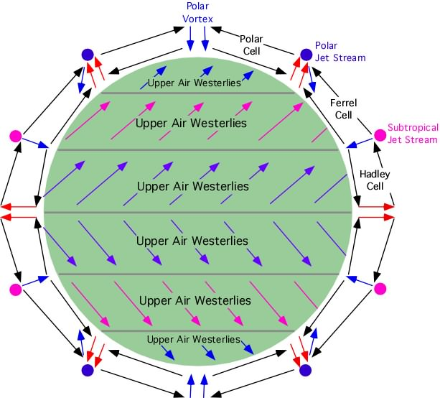
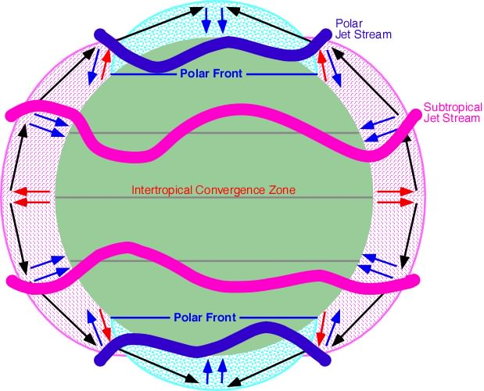
tsV izokg ¼Jet stream½

